Slide 1
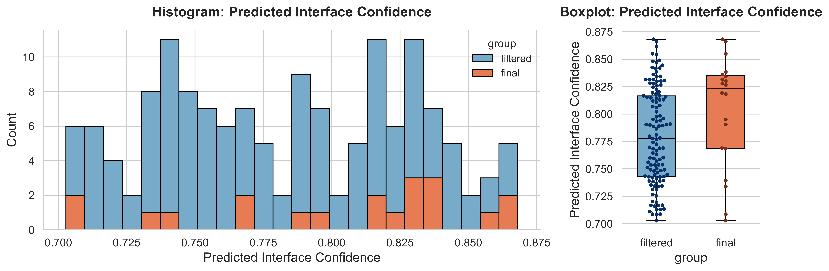
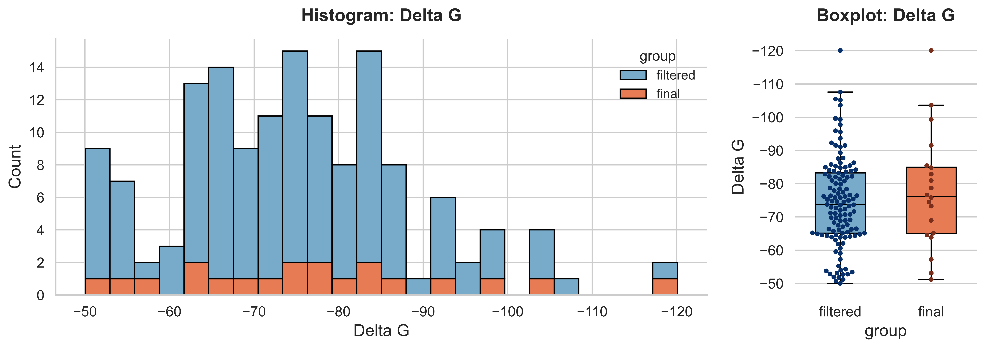
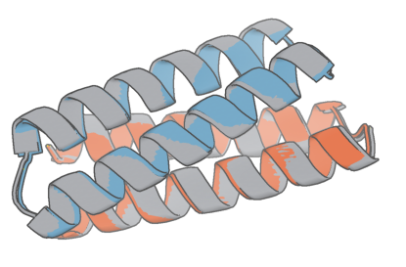
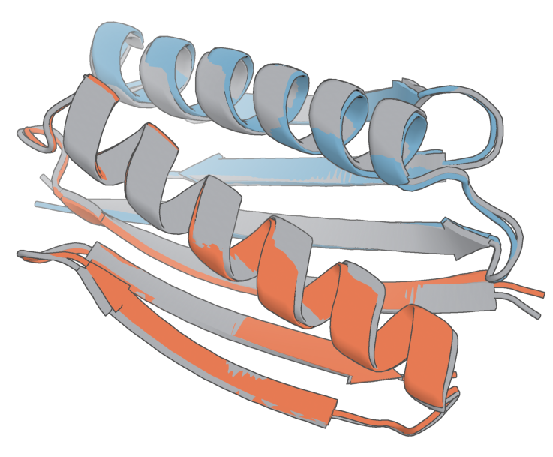
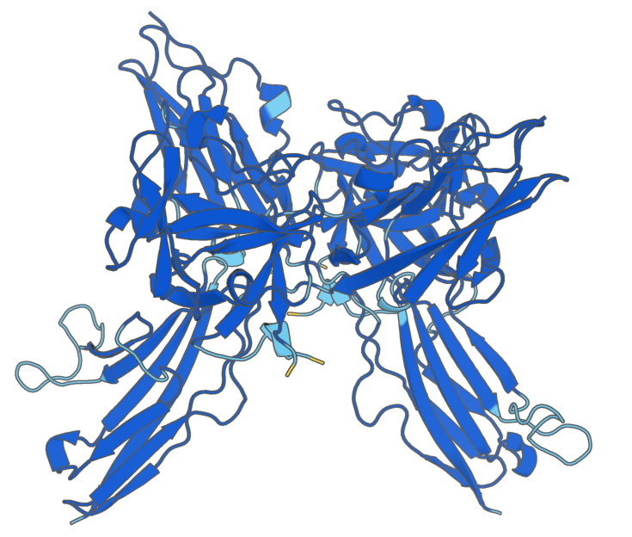
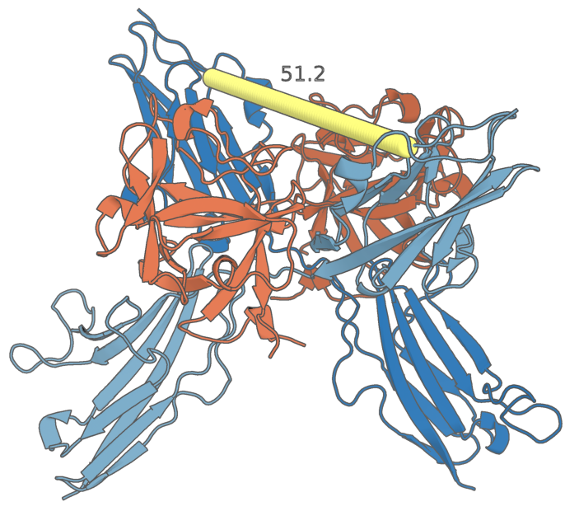
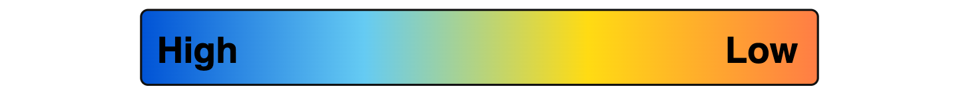
Towards the Design of an FGF Signaling Agonist
Kaavya Uppala¹, Adam T. Smiley, Ph.D.², Douglas G. Brownfield, Ph.D.^{1.2}
¹Division of Biochemistry and Molecular Biology, ²Department of Pulmonary and Critical Care Medicine
Background
methods
results
Discussion
  What is fgf signaling?
  FGF signaling is a major developmental pathway involved in organ development. The Brownfield Lab is focusing on its role in developing the lung’s alveolar epithelium
Design homodimers in silico
Create de novo homodimers that may be able to lock the Fgfr2 in a pro-signaling conformation:
Generate protein backbones via RFDiffusion3
Generate homodimer sequences via LigandMPNN
Validate structures with Chai1
In silico evaluation to select the 20 homodimer designs for in vitro testing
Figure 5: Filtered vs. Final Design Metrics
Successfully designed homodimers in silico
  Started with 30,000 protein backbones → Down-selected based on size and directionality
  Designed 4 sequences per backbone
  Validated by predicting structures for those sequences
  Filtered to 125 designs based on interface characteristics
  Selected 20 final designs
Comprehensively evaluated the interactions between all homodimer combinations in silico via iPTM metrics
Cognate homodimer generally have the most confident interactions
Some designs have off target interactions → Models create idealized structures, so designs share a lot of structural similarities
  Fgfr2 LIGAND-receptor interaction
  Ligands, such as Fgf10, bind to their receptor, Fgfr2, to mediate signaling.
  Signaling complex with a 2-2-2 stoichiometry
  Co-localization of internal kinases leads to downstream signaling
Figure 1: FGF Signaling Components
Figure 3: Protein Design Workflow
Figure 6: Sample Final Homodimers
Future directions
Complete the screen to evaluate homodimers in vitro (in-progress)
Extend the Fgf10 ligand into a high performing obligate homodimer to fix the FGF complex in a pro-signaling conformation
Potential clinical applications for improving alveolar health after injury
  Designing a fgf signaling agonist
  Trapping Fgf10 ligands into a pro-signaling conformation will likely boost signaling, so we propose turning Fgf10 into a rigidly constrained homodimer primed for receptor binding
  Design obligate homodimers that fit the size and orientation constraints of the space between the Fgf10 ligands
  Extend the native Fgf10 ligands into high performing homodimers to activate the Fgfr2 receptors by rigidly trapping them in a pro-signaling conformation
Design 19
RMSD = 0.460 Å
Test homodimers in Vitro
Perform a live-dead screen to evaluate homodimers:
Use a split beta-lactamase protein complementation assay to evaluate de novo homodimer binding specificity and strength
Strongly associating homodimers should reconstitute the beta-lactamase fragments, thus conferring antibiotic resistance and survival
Evaluate homodimer specificity via combinatorial testing → 400 homodimer structure complexes
Design 9
RMSD = 0.440 Å
Design
Predicted Structure
Figure 7: iPTM Heatmap
references
Brownfield, D.G., de Arce, A.D., Ghelfi, E. et al. Alveolar cell fate selection and lifelong maintenance of AT2 cells by FGF signaling. Nat Commun 13, 7137 (2022). https://doi.org/10.1038/s41467-022-34059-1
Goetz, R., Mohammadi, M. Exploring mechanisms of FGF signalling through the lens of structural biology. Nat Rev Mol Cell Biol 14, 166–180 (2013). https://doi.org/10.1038/nrm3528
Butcher J, Krishna R, Mitra R, Brent RI, Li Y, Corley N, Kim PT, Funk J, Mathis S, Salike S, Muraishi A, Eisenach H, Thompson TR, Chen J, Politanska Y, Sehgal E, Coventry B, Zhang O, Qiang B, Didi K, Kazman M, DiMaio F, Baker D. De novo Design of All-atom Biomolecular Interactions with RFdiffusion3. bioRxiv [Preprint]. 2025 Nov 19:2025.09.18.676967. doi: 10.1101/2025.09.18.676967. PMID: 41000976; PMCID: PMC12458353.
Dauparas J, Anishchenko I, Bennett N, Bai H, Ragotte RJ, Milles LF, Wicky BIM, Courbet A, de Haas RJ, Bethel N, Leung PJY, Huddy TF, Pellock S, Tischer D, Chan F, Koepnick B, Nguyen H, Kang A, Sankaran B, Bera AK, King NP, Baker D. Robust deep learning-based protein sequence design using ProteinMPNN. Science. 2022 Oct 7;378(6615):49-56. doi: 10.1126/science.add2187. Epub 2022 Sep 15. PMID: 36108050; PMCID: PMC9997061.
Boitreaud, Jacques & Dent, Jack & Mcpartlon, Matthew & Meier, Joshua & Reis, Vinicius & Rogozhonikov, Alex & Wu, Kevin. (2024). Chai-1: Decoding the molecular interactions of life. 10.1101/2024.10.10.615955.
Löfdahl PA, Nord O, Janzon L, Nygren PA. Selection of TNF-alpha binding affibody molecules using a beta-lactamase protein fragment complementation assay. N Biotechnol. 2009 Nov 30;26(5):251-9. doi: 10.1016/j.nbt.2009.06.980. Epub 2009 Jul 1. PMID: 19576305.
Acknowledgements: Dr. Adam Smiley, Dr. Douglas Brownfield, Brownfield Lab, Mayo SURF Program
Figure 2: Fgfr2b Receptor + Fgf10 ligands
Figure 4: In Vitro Screen
Fgfr2b Receptor
Fgf10 Ligand

